Slide 1
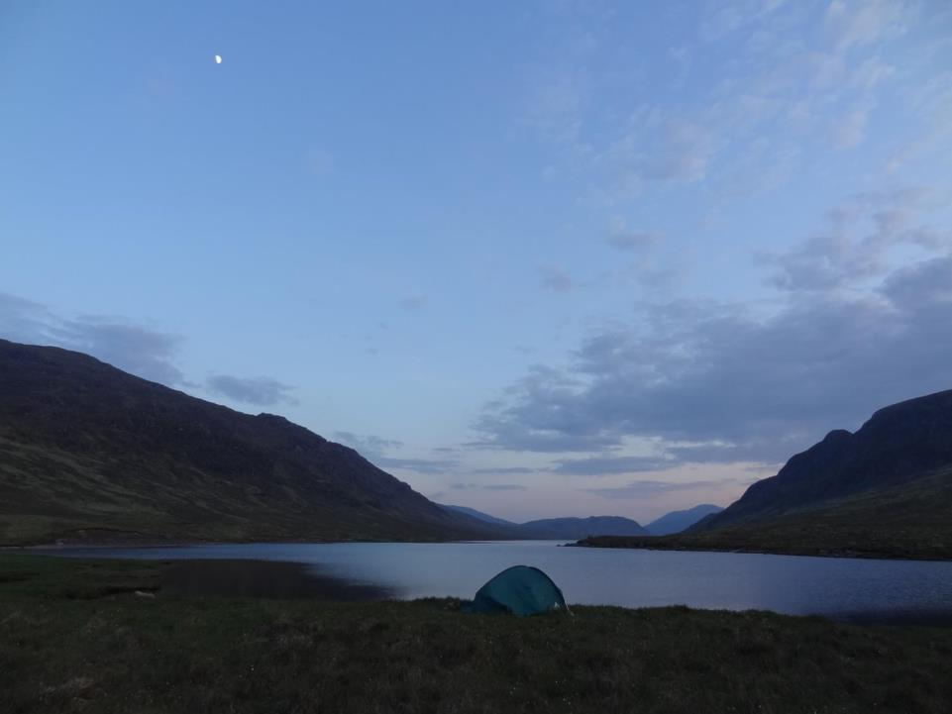
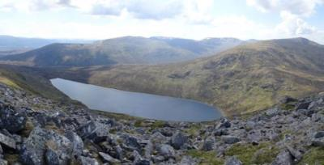
The Ardverikie Hill Lochs
and Munros
EARBA 1800 MW
this very large Pumped Storage Hydro (PSH) is with
Scottish Ministers for approval
it is one of five ‘new wave’ mega-PSH schemes in the Highlands
these are examined here for their upland landscape ‘fit’
how does Earba compare ? not at all well ...
yes, Scotland must urgently meet climate targets
yes, surplus green energy must be saved - including pumped storage
yes, local communities matter just as much as the hillgoing community
but - we can Save Our Munros - and cherish our hill lochs - too

Slide 2
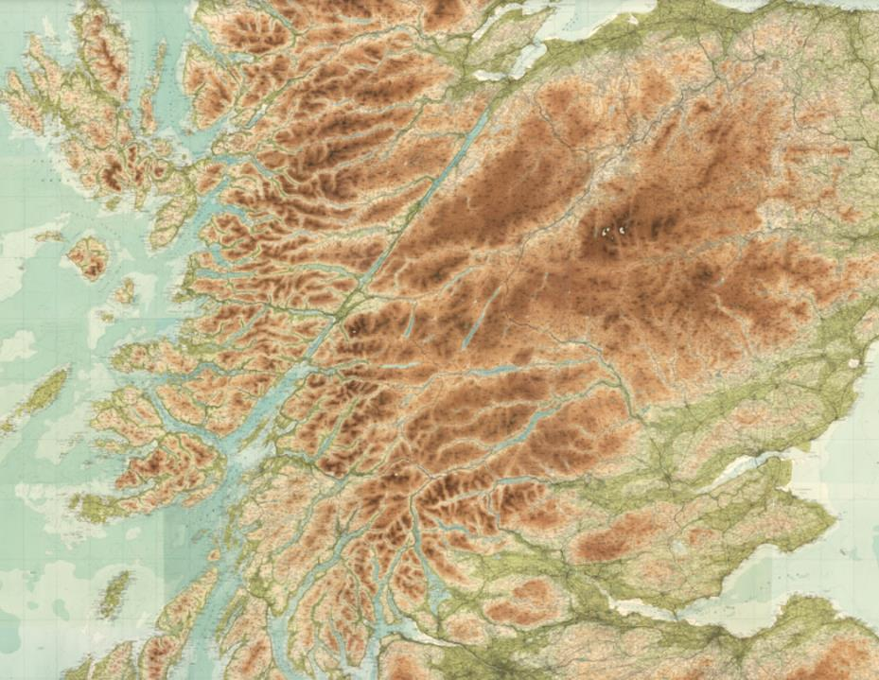
keep Scotland’s Munros wild
Inverness
Ft William
Pumped storage hydro PSH
schemes in the Highlands May24
operational 300/440 MW
proposed 450/600 MW
upgrade/conversion 1000 MW+
proposed 1500-2000 MW
potential conversion
Edinburgh
Glasgow

Slide 3
keep Scotland’s Munros wild
Inverness
2 Earrach
Loch Ness group
moorland locations
low-moderate landscape intrusion
4 Fearna
M
M
Beauly - Denny
1 Coire Glas
located within the Munros
- high intrusion
- consented (Coire Glas)
M
M
Pumped storage hydro PSH
Ft William
5 Earba
M
schemes in the Highlands May24
operational 300/440 MW
proposed 450/600 MW
upgrade/conversion 1000 MW+
proposed 1500-2000 MW
potential conversion
Argyll group
existing mountain locations
Cruachan
moorland location with
low landscape intrusion
3 Ballimeanach
impacts on the Munros
Edinburgh
Glasgow

Slide 4
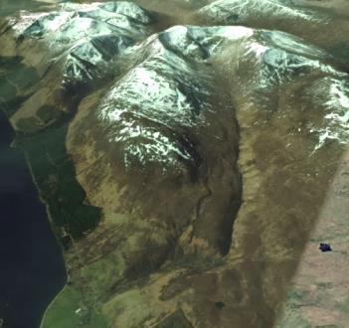
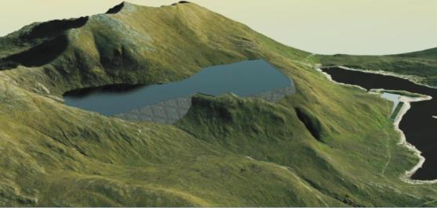
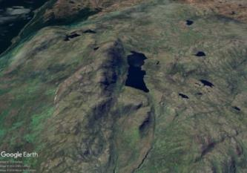
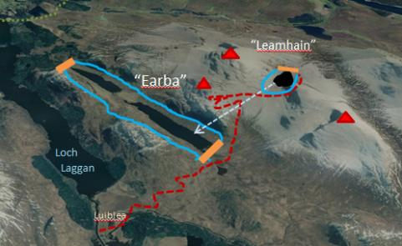
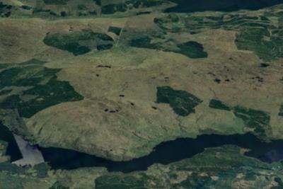
4 Fearna 1800 MW
Loch Cuaich
1 Coire Glas 1300 MW
Loch
Lochy
Loch
Ness
The Big Five ...each will be examined in turn
1 Coire Glas (approved) is well-contained within a trough-head, no impact on hill access, tolerable impact on the Munros above - see also Cruachan
- but not to be taken as precedents for any more invasions of The Munros
2 and 3 are in knolly moorland locations, little visited, no impact on Munros or hillgoing
4 Fearna would bulk large in the classic Quoich Munros circuit, cutting the path, with an ugly draw-down basin most of the day and prominent access tracks
5 Earba would drown lovely valley lochs and a fine corrie lochan, destroying old paths, and wholly altering the popular Ardverikie Three Munro-circuit
.
o
2 Earrach 2000 MW
3 Ballimeanach 1500 MW
the
Ardverikie
Munros
Loch Awe
5 Earba 1800 MW

Slide 5
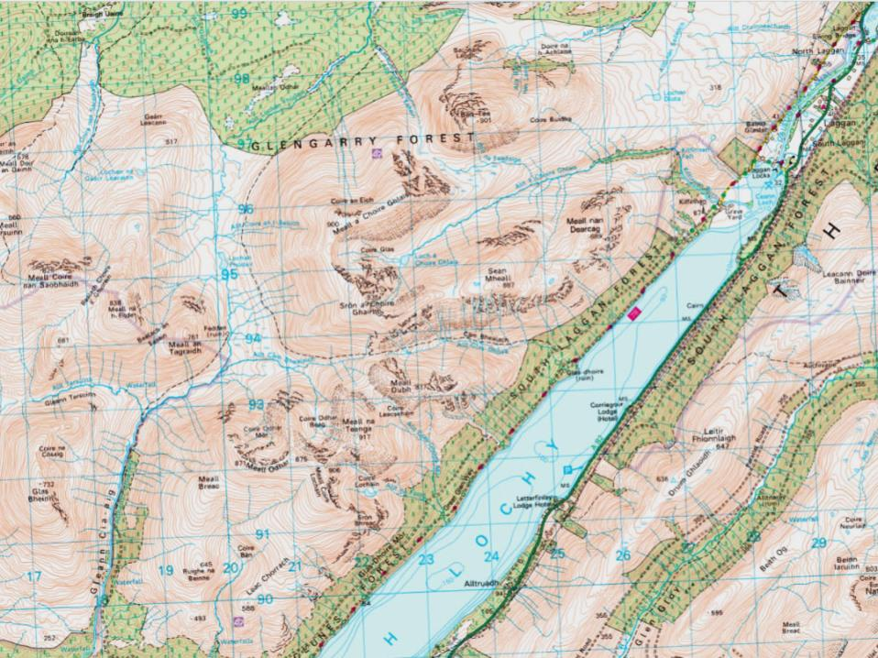
Loch Lochy Munro group
two Munros
one Corbett
usual walking routes (yellow) do not enter Coire Glas, or follow its rim - and are unaffected by access roads or other works (except Ben Tee, minor)
Ben Tee 901
Laggan
Sron a’ Choire Ghairbh
935
A82
1 Coire Glas 1300 MW
Meall na Teanga
917
within Munro mountain area but moderate impact next slide
consented 2018
site investigations under way
public land (Forestry)
Loch Lochy

Slide 6
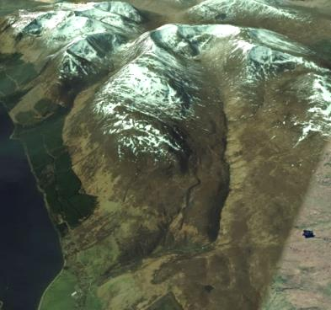
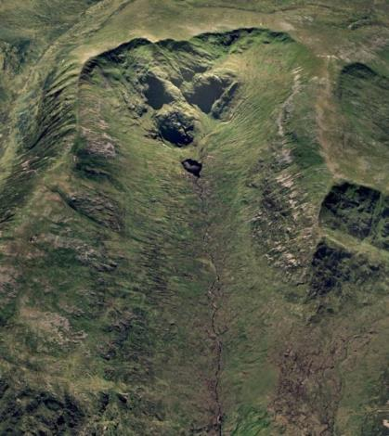
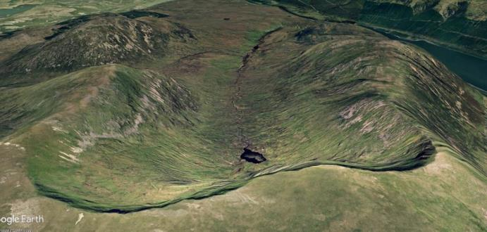
Loch
Lochy
1 Coire Glas 1300 MW
Ben Tee 901
a reasonable ‘fit’ in a big landscape
- similar to Cruachan (next)
new ‘lochan’ has a large 100 m high dam, but not seen from any main hills
it is contained within the broad glacial trough-head (not a true corrie) - in scale with its setting
the present floor is a dull boggy waste with a tiny lochan
walkers briefly gain the summit from behind
they will see the lochan far below them, and ugly drawdown, but not spoiling much-loved views
Sron a’ Choire
Ghairbh 935

Slide 7
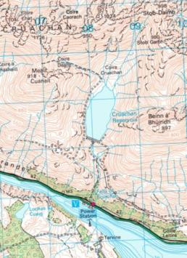
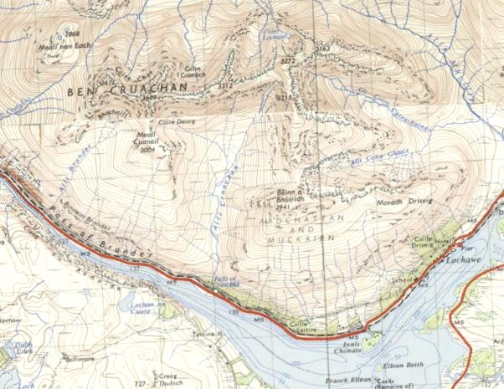
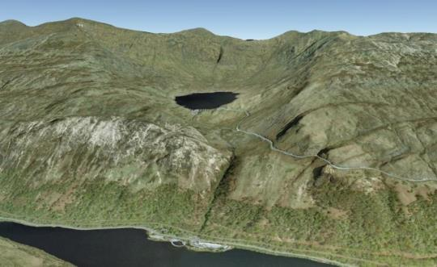
Ben Cruachan 1126
Stob Daimh 998
400
was a featureless open side valley
Cruachan 1040 MW
upgrade from present 440 MW - no change to reservoir
shown here as a landscape comparator for Coire Glas :
dam only 40 m high, is contained within natural basin
as at Coire Glas, not a true corrie
was previously a featureless open side valley
new ‘lochan’ is large but does not despoil main vistas from Munro summits high above
main detractors are draw-down scar and access road
native woodland creation would help blend them in
Loch Awe

Slide 8
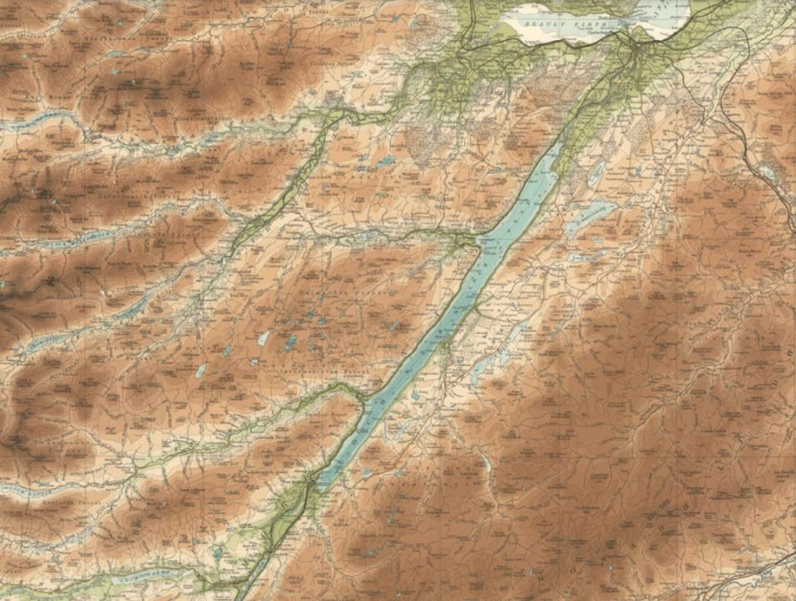
Inverness
Loch Ness group
Loch na Cathrach
450 MW formerly Red John
higher moorland location
moderate landscape intrusion
next slide
mid-level locations
low landscape intrusion
2 Earrach
2000 MW
Foyers 300 MW
Loch Kemp 600 MW
Fort Augustus
existing scheme in higher moorland,
adjacent to a Corbett
similar character to PSH, might lend
itself to conversion as with Sloy
Glen Doe ?

Slide 9
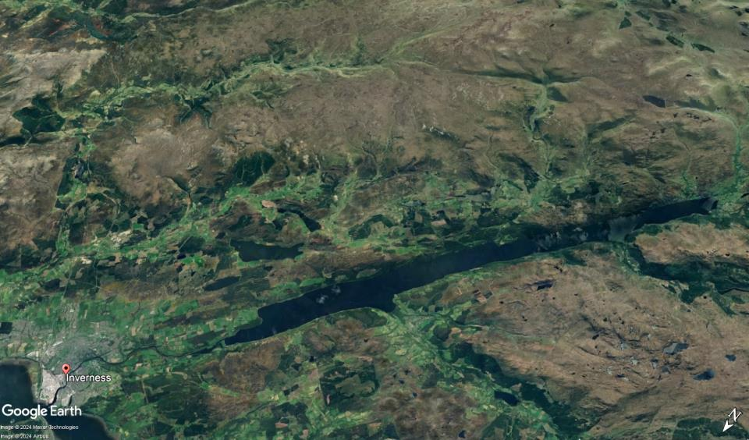
Monadhliath
Glen Doe
conversion ?
Loch Ness group
Loch Kemp
600 MW
Foyers
300 MW
Fort
Augustus
Loch na Cathrach
450 MW
Loch Ness
2 Earrach
2000 MW
Drumnadrochit
all these sites are in moorland locations
there are no Munros in this view, one Corbett at Glen Doe
the reservoir ‘lochans’ will be well concealed in woodland or intricate low hills
there are important community concerns, including over Loch Ness water level fluctuations and new power lines

Slide 10
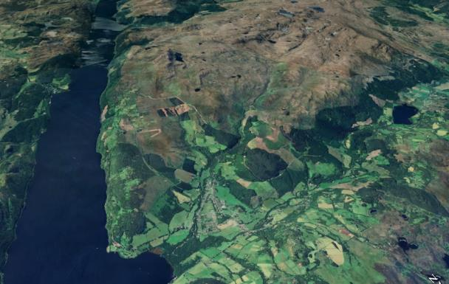
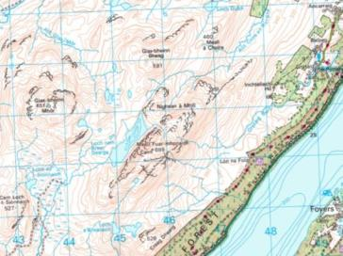
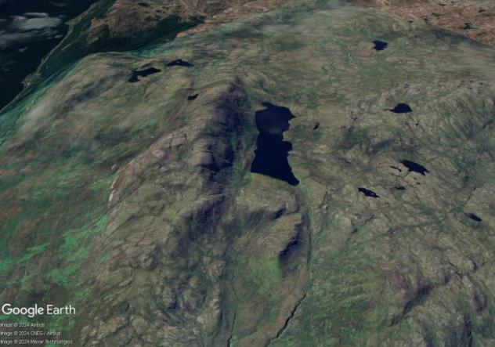
Drumnadrochit
Loch Ness
.
keep Scotland’s Munros
wild - this one does
Meallfuarvonie
699
2 Earrach 2000 MW
enlarged upland ‘lochan’ in knobbly moorland
(diagrammatic as no plans available on web)
Meallfuarvonie / Meall Fuar-mhonaidh
is a popular local walk
views from the top will be radically altered, including with permanent access tracks
but it already looks across Levishie wind farm
moorland location
moderate landscape intrusion
at only 2130 feet in height it is well below Corbett height, let alone Munro

Slide 11
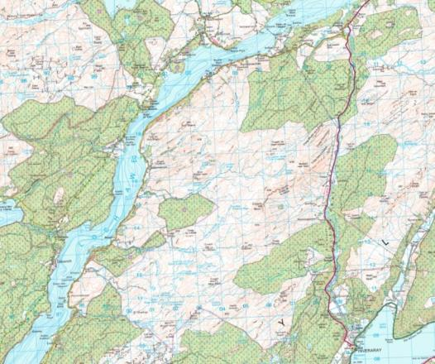
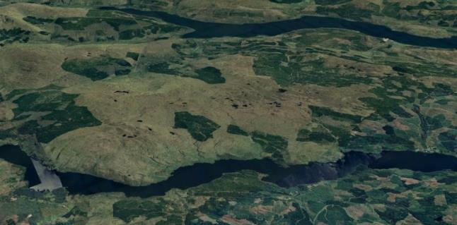
Argyll group - Loch Awe
3 Ballimeanach 1500 MW
new upland ‘lochan’ in low knobbly moorland
(diagrammatic as no plans available on web)
no impact on any mountain areas
uses Loch Awe (as does Cruachan)
with every scheme, there will be community impacts and local landscape concerns to be fully respected, and sensitive design and minimal imprint are essential
Inveraray
Loch Fyne
Inveraray
keep Scotland’s Munros
wild - this one does
Loch Awe

Slide 12
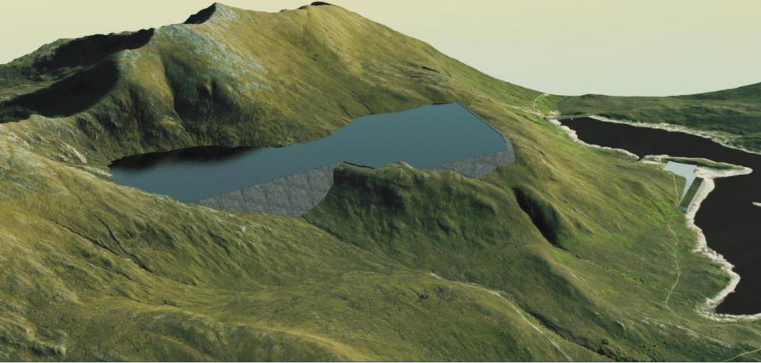
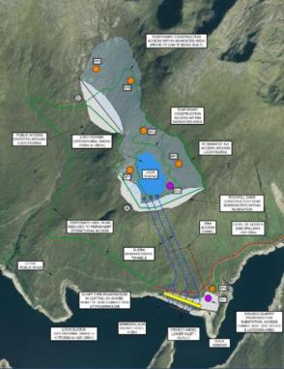
Spidean Mialach 996m
4 Fearna 1800 MW
Quoich dam
Loch Cuaich
(Quoich)
Gleouraich 1035m
unlike Coire Glas or Earrach, this megascheme creates an unnaturally shaped, outsized water body perched across a prized Munro landscape
it is only in ‘scoping’ but the impact is vastly greater than anything seen before.
the Quoich dam - one of the largest - is 350 m long and 35 m high
the combined dam lengths seen here are five times as long - about 1800 m, with main dam about 80 m high
the water body raises Loch Fearna by 62 m and extends it into Coire Dubh (which lacks a lochan)
this artist’s impression is deceptive - it does not show the permanent access tracks scarring rugged terrain, the stark dam tops, or the daily near-emptying drawdown
a smaller scheme creating a ‘corrie lochan’ in Coire Dubh would be much less harmful

Slide 13
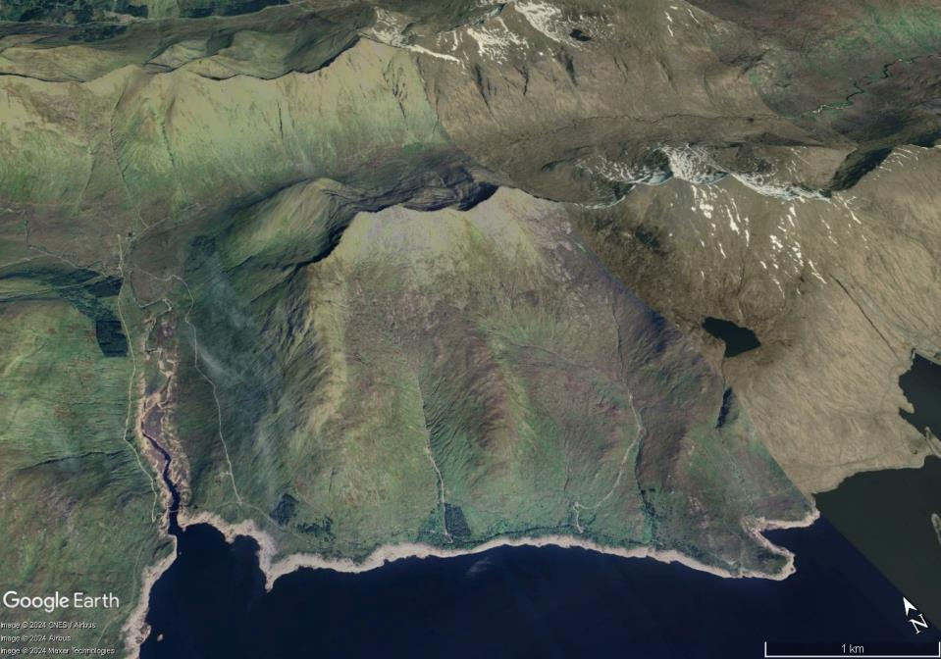
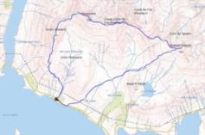
Fearna 1800 MW
Spidean Mialach 996m
Gleouraich 1035m
*
*
*
Loch Fearna is a shallow shelf lochan, not in a corrie, a pleasing incident in the views
new run-of-river hydro schemes
- major visual intrusions, unrestored
*
*
*
Loch Cuaich
(Quoich)
this is the classic ridge walk along the “Quoich Munros”
the ascent is by one of the finest stalker’s paths in the Highlands (Hamish Brown’s favourite) with 32 zigzags
it is one of the most prized - and popular - day circuits north of the Great Glen
“a most enjoyable hike following stalker's paths and ridges” - Steve Fallon Guide (same circuit)
WalkHighland route map

Slide 14
Fearna 1800 MW
walkers along the best stretch of ridge will have a full view onto the huge dams, the unnatural ‘water body’, and the permanent access roadways
Spidean Mialach 996m
Gleouraich 1035m
*
*
views
most of New Loch Fearna will be exposed through the day as drawdown proceeds
*
new run-of-river hydro schemes
- tracks scarring the glen and corries
*
the direct return route will be severed, with a lengthy detour
- most will just follow the hydro tracks
*
*
Loch Cuaich
(Quoich)
this is the classic ridge walk along the “Quoich Munros”
the ascent is by one of the finest stalker’s paths in the Highlands (Hamish Brown’s favourite) with 32 zigzags
it is one of the most prized - and popular - day circuits north of the Great Glen
“a most enjoyable hike following stalker's paths and ridges” - Steve Fallon Guide (same circuit)
WalkHighland route map

Slide 15
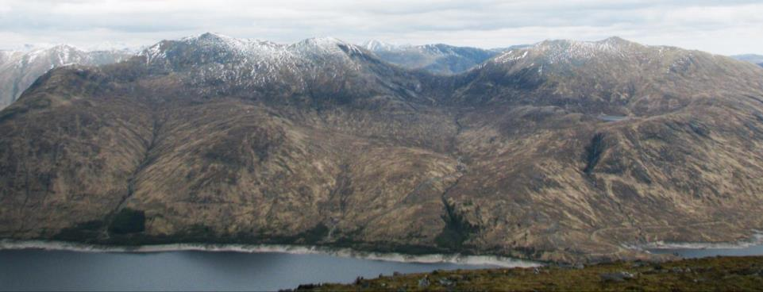
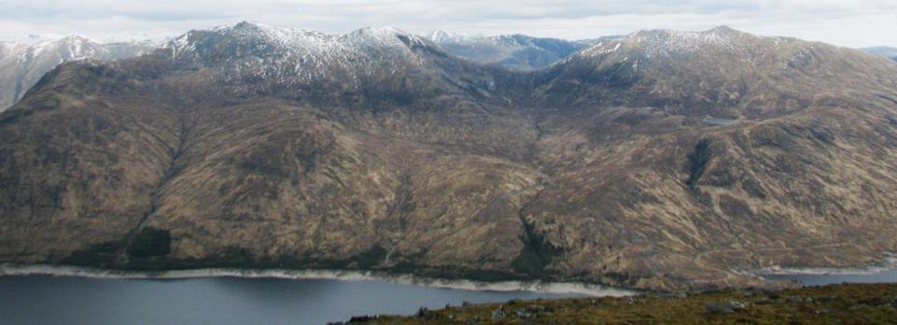
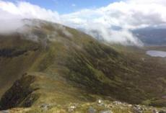
Gleouraich 1035m
Spidean Mialach 994m
Fiar Bhealaich
the rugged traverse between the Munros across the Fiar Bhealaich
is the highpoint of the day
Coire Dubh
Loch Fearna
Loch Cuaich
Fearna 1800 MW
Gleouraich 1035m
Spidean Mialach 994m
draw-down
draw-down
Fiar Bhealaich
draw-
down
permanent access roadway
view from the Munro Gairich 919m opposite
- also from Sgurr Mor Munro range to west
this industrial complex must very seriously detract from simple enjoyment of these Munros

Slide 16
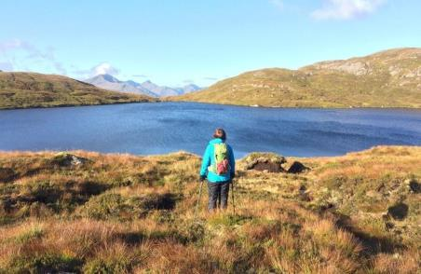
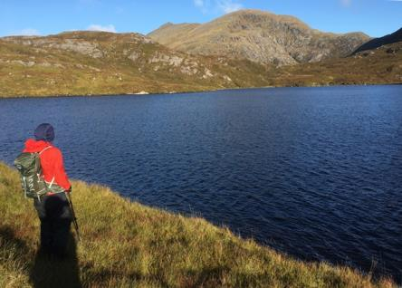
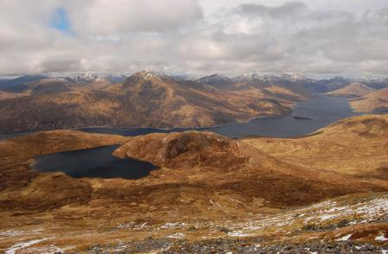
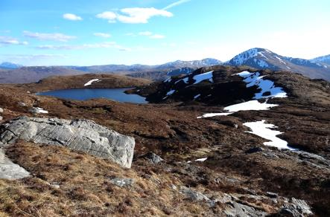
on the top website, WalkHighland, there are 42 fully illustrated walk reports for this circuit
- there are 140 ‘likes’ since 2008, and countless more ‘hits’ will have been made
- many of them notice Loch Fearna as a pleasing feature, some visit it...
the access roadway will follow the surviving rocky crest between the two dams (dashed pink)
Fearna 1800 MW
draw-down

Slide 17
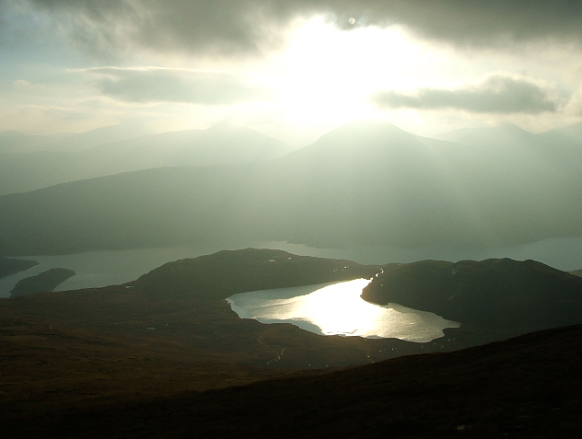
Loch Fearna “shelf lochans” of such rugged delicacy are rare
WalkHighland website

Slide 18
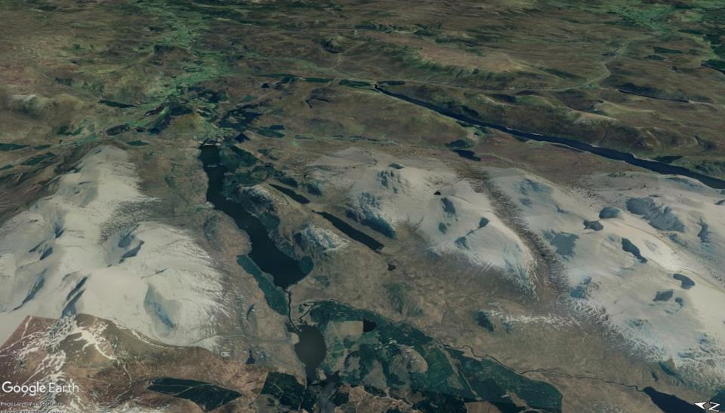
Spey
5 Earba 1800 MW
Cairngorms National Park
Laggan
Loch
Ericht
Ardverikie
“Leamhain”
“Earba”
the
Ardverikie
Munros
Ben Alder
Loch
Laggan
Creag
Meagaidh
Luiblea
proposed Lochaber National Park
Spean
this overview conveys the enormous, unprecedented scale of this ambitious scheme
  the unified “Loch Earba”, raised by 21 m, is over half the length of Loch Laggan
  formerly slender, it is doubled in width (at the waist), with unnaturally high shorelines
  the existing hill loch, already the largest in the area, is hugely expanded with a dam bulging out well beyond the natural mountain front - its water level raised by 70 metres
  a permanent access roadway will zigzag across the flank of one of the Three Munros, and cross the high col between the other two

Slide 19
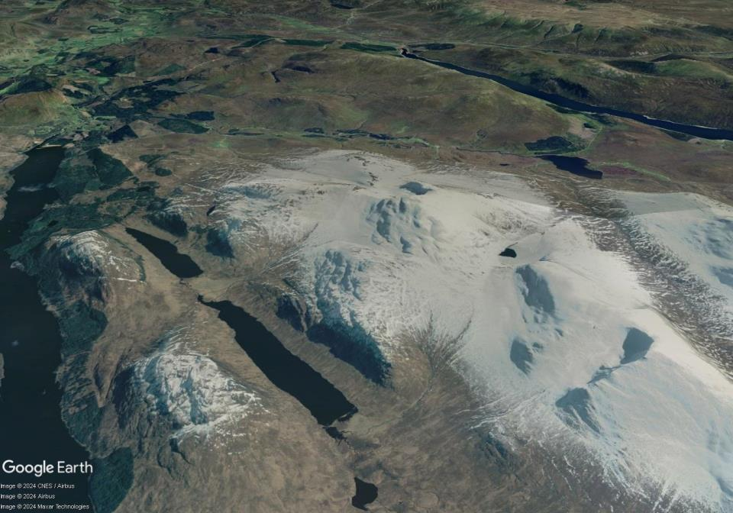
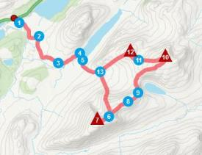

1087 Beinn a’ Chlachair
1049 Mullach Coire an Iubhair
924 Creag Pitridh
5 Earba 1800 MW
Loch Bealaich Leamhain
Ardverikie
House
pony path over to
Pattack
1
1049
924
corrie
headwall
traverse
Am Magh
Lochan na h-Earba
1087
estate track
from A86
“Ardverikie Forest is a wild area“
rating 8/10 on his ‘fab’ scale
the Ardverikie Three - the usual round - also WalkHighland

Slide 20
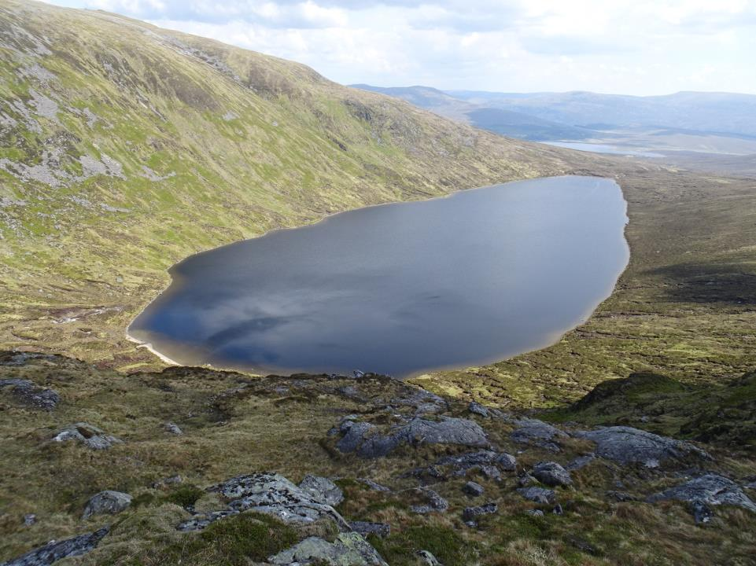
the upper water body will almost empty through the day
the lower water body will have a 20 m drawdown scar
5 Earba 1800 MW
1087 Beinn a’ Chlachair
1049 Mullach Coire an Iubhair
924 Creag Pitridh
the corrie lochan
Loch a’ Bhealaich Leamhain
two special landscape/historic features will be lost :
the unusual large debris fan of Am Magh
the finest stretch of stalkers path in the area
along with the only good wild camping grounds for miles
Loch a’ Bhealaich Leamhain
Ardverikie
House
pony path over to
Pattack
1
1049
924
corrie
headwall
traverse
Am Magh
740
new permanent
access roadway
Lochan na h-Earba
1087
existing estate track
from A86 Luiblea
“Ardverikie Forest is a wild area“
rating 8/10 on his ‘fab’ scale
the Ardverikie Three - the popular round - as also WalkHighland

Slide 21
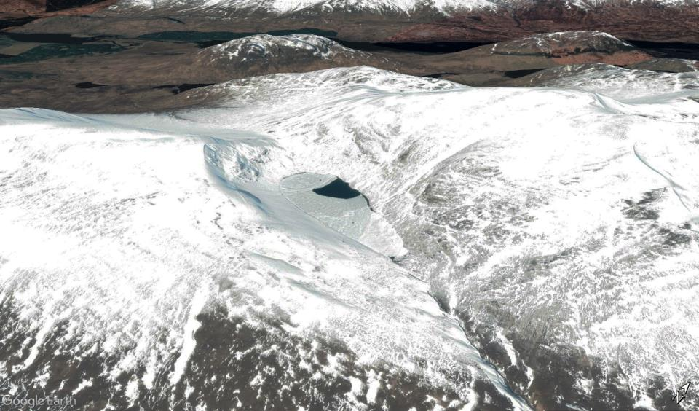
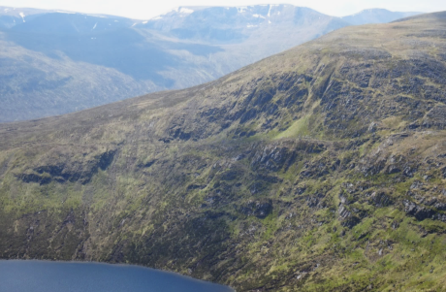
Loch Laggan
Earba 1800 MW
the corrie lochan
924 Creag Pitridh
Beinn a’ Chlachair
1087
1049
Mullach Coire an Iubhair
(Geal Charn)
*
Loch a’
Bhealaich
Leamhain
corrie headwall traverse
*
this historic pony path follows a rock shelf across the crags, one of the best to enjoy in the Highlands
*
this fine, much-photographed hill lochan is the largest in the
Ben Alder-Meagaidh ranges, a pearl beautifully fitting its corrie
the pass, Bealach Leamhain, is the best feature on the round of the Ardverikie Three Munros

Slide 22
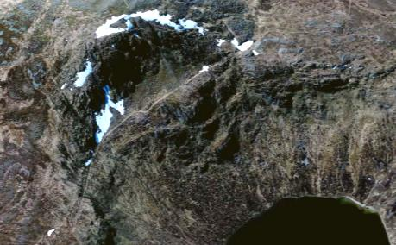
Earba 1800 MW
the corrie lochan
924 Creag Pitridh
Beinn a’ Chlachair
1087
1049
Mullach Coire an Iubhair
(Geal Charn)
735
the dam, almost 1 km long and 100 m high, will be startlingly bold in
close views (3-7 km) from the Ben Alder Munros
longer views (10-15 km) from the Drumochters and Gaick rim
710
the reservoir will reach almost to the pass between the Munros
- it will be draining down through the day to leave a massive bare scar
640
the access roadway will require a huge cliff cutting (detail unknown)
- and it will obliterate the ‘rock shelf’ traverse path

Slide 23
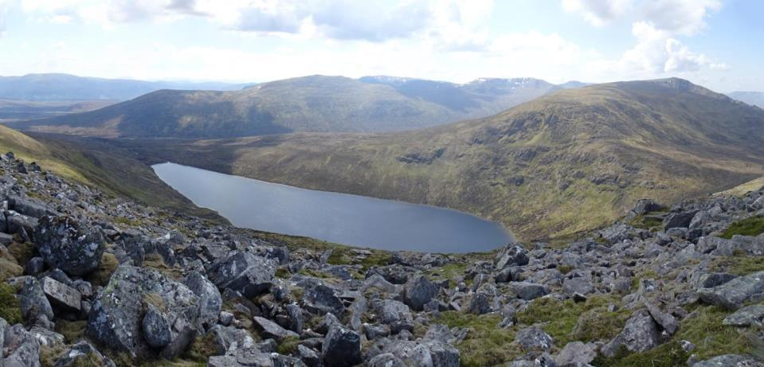
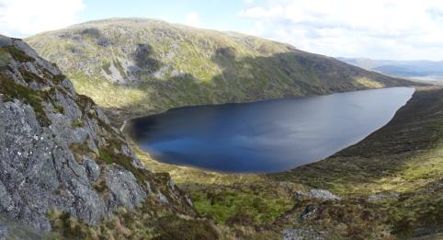
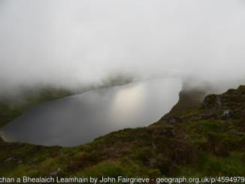
the remarkable pony path appears on the first OS maps of ~1875
- the branch was added later
Earba 1800 MW
the corrie lochan
Ben Alder
Beinn a’ Chlachair
Loch a’ Bhealaich Leamhain
Mullach Coire an Iubhair

Slide 24
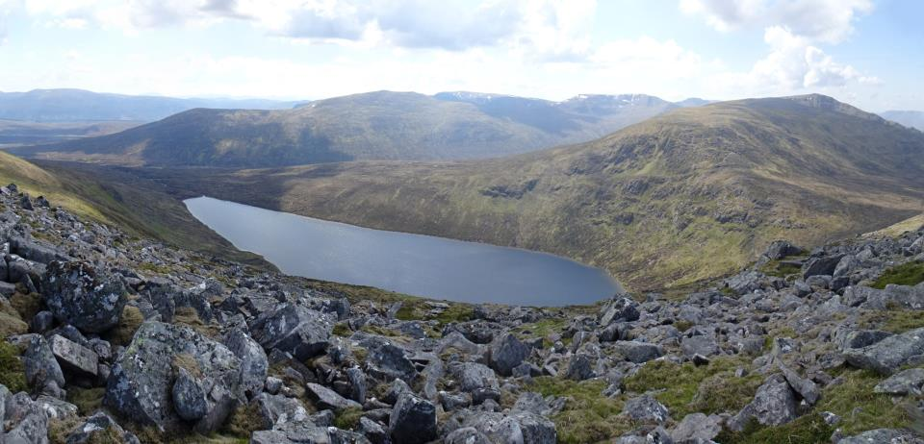
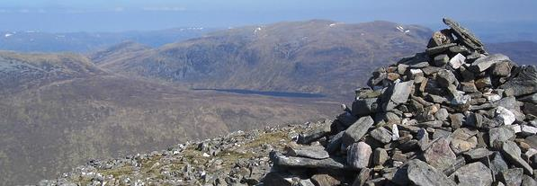
Earba 1800 MW
the corrie lochan
Carn Dearg
Ben Alder
Beinn a’ Chlachair
Bealach Leamhain
draw-down
Loch a’ Bhealaich Leamhain
Mullach Coire an Iubhair
viewed from Carn Dearg (Ben Alder)
WalkHighland website

Slide 25
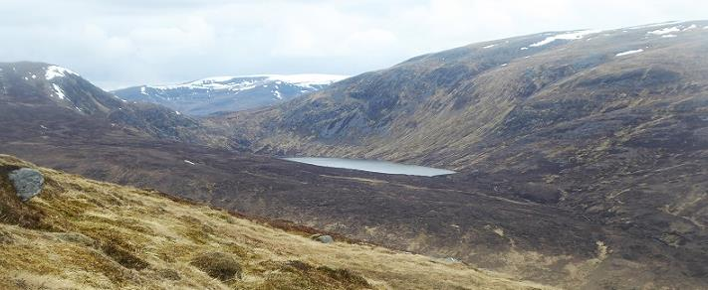
from below Carn Dearg
Nick Kempe

Slide 26
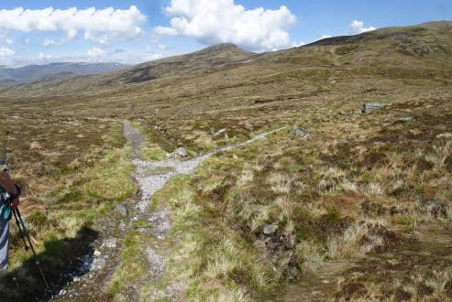
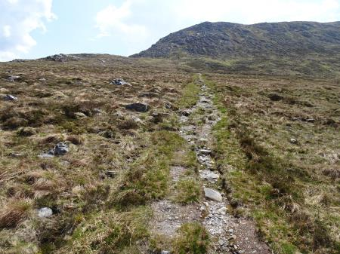
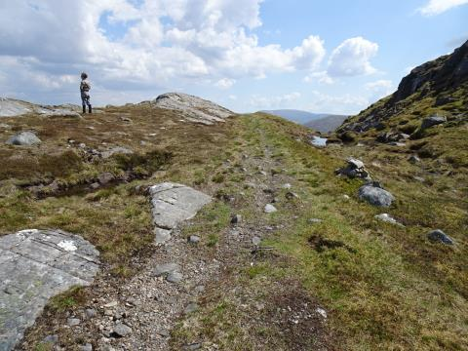

track to dam through this notch
Bealach Leamhain - the col crossed by all Munro goers
- to be a cat’s cradle of access roadways and installations
... and over this brow
... and along this shelf ...
with unknown rock cutting wall and embankments

Slide 27



Earba 1800 MW
the corrie lochan
new track eliminates this historic path

Slide 28


Slide 29


5 Earba 1800 MW
Binnein Shios
Ardverikie
the twin lochs
Lochan na h-Earba
Creag a’ Mhaigh
Binnein Shuas
Am Magh
Creag Pitridh
Loch Laggan
Lochan na h-Earba
if this group of striking yet accessible hills was in the Lake District - where Buttermere is a comparable split lake - it would be cherished and on every calendar
this remarkable, almost unique parallel through valley
possesses a rare double loch, divided by the exceptional debris fan of Am Magh (Moy Green or The Flats)
- the only other prime camping pitch in the area
Scotland has just one other double loch - Balqhuidder
prime pitch lost to dam and access roadways
Keith Miller

Slide 30


Earba 1800 MW
the twin lochs
Ardverikie
Wall
Lochan na h-Earba
DAM
access roadways
POWER
STATION
*
*
this splendid camping ground is the only one on the Ardverikie Three circuit

Slide 31


Earba 1800 MW
the twin lochs and Am Magh
Am Magh
Am Magh
both these viewpoints towards the NE loch and future dam will be well below new water level

Slide 32

new shoreline 20+ metres up, almost at this low col
Am Magh
these shallows, peaty shores, and damp flats are rich, extensive, and scarce habitats for waterlife, birds, plants, insects -- they will not be replaced along the steep, new, unnatural shorelines

Slide 33


Earba 1800 MW
the twin lochs and Am Magh
Binnein Shuas
Binnein Shios
despite grey light, the exceptional quality of Am Magh (Moy Green in the Estate archives) stands out - a true oasis, and winter sanctuary for the deer
wild camping places of rare quality and seclusion, irreplaceable in this range

Slide 34


the unusual large debris fan of Am Magh (Moy Green), dividing the original lake, still with vigorous spates
a meandering burn links the two lochs through scattered trees
deer graze the ‘good bite’ (Earba = hind or roe deer)
three pairs of snipe may nest here - and can be heard drumming at night - from a tent on grass or shore
Earba 1800 MW
the twin lochs

Slide 35





Earba 1800 MW
the twin lochs and Am Magh
one of the best high-rising hill paths in the region starts here and - beautifully constructed - leads into lovely Coire an Iubhair, a link with the history of the Estate; its start will now be from a large new dam- access track cut into the hillside
Mullach Coire an Iubhair
Creag Pitridh
Flats-camp
Am Magh
shore camp
a burnside bike-camper relict pines
cairn marking start of our path tomorrow

Slide 36

Lochan na h-Earba
this image from Binnein Shuas is just of two dozen in a WalkHighland post, nearly all of them revelling in the twin loch on a glorious autumn day
https://www.walkhighlands.co.uk/Forum/viewtopic.php?f=9&t=102056
- there are 16 walk reports for Binnein Shuas alone, with scores of ‘likes’

Slide 37


